Slide 1
Android Tutorial
Larry Walters
OOSE Fall 2011

Slide 2
References
This tutorial is a brief overview of some major concepts…Android is much richer and more complex
Developer’s Guide
  http://developer.android.com/guide/index.html
API Reference
  http://developer.android.com/reference/packages.html

Slide 3
Tools
Phone
Eclipse ( http://www.eclipse.org/downloads/ )
  Android Plugin (ADT)
Android SDK ( http://developer.android.com/sdk/index.html )
  Install everything except Additional SDK Platforms, unless you want to
Windows Users: may need to install Motorola Driver directly ( http://www.motorola.com/Support/US-EN/Support-Homepage/Software_and_Drivers/USB-and-PC-Charging-Drivers )

Slide 4
Android SDK
Once installed open the SDK Manager
Install the desired packages
Create an Android Virtual Device (AVD)

Slide 5
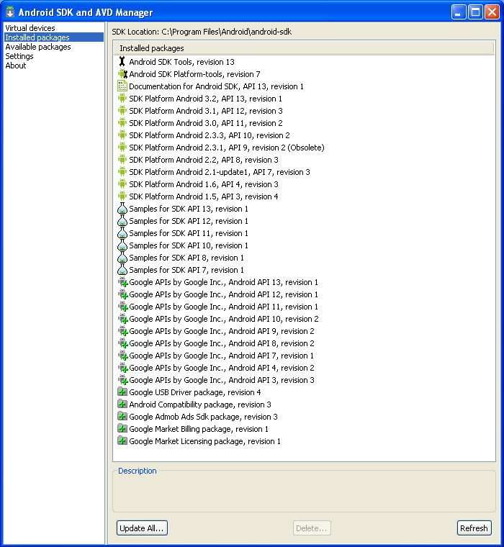
SDK Manager

Slide 6
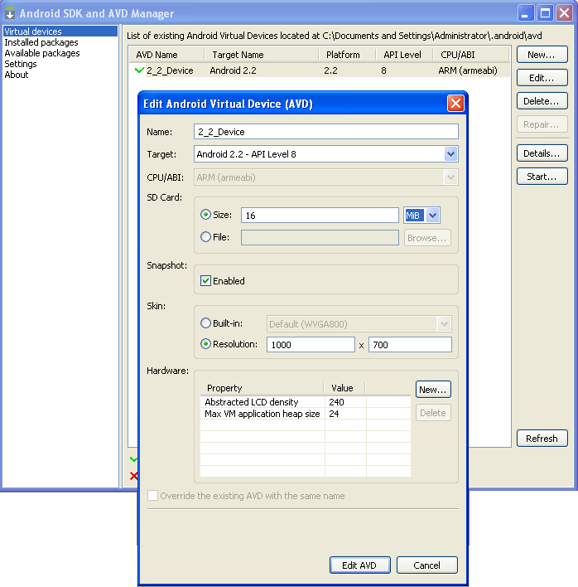
AVD

Slide 7
ADT Plugin (1)
In Eclipse, go to Help -> Install New Software
Click ‘Add’ in top right
Enter:
  Name: ADT Plugin
  Location: https://dl-ssl.google.com/android/eclipse/
Click OK, then select ‘Developer Tools’, click Next
Click Next and then Finish
Afterwards, restart Eclipse
Specify SDK location (next 3 slides)
  Must do this every time start a new project in a new location (at least in Windows)

Slide 8
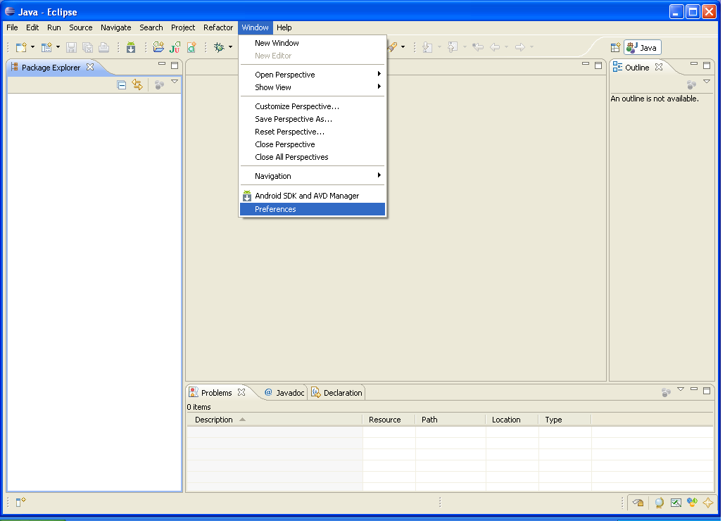
ADT Plugin (2)

Slide 9
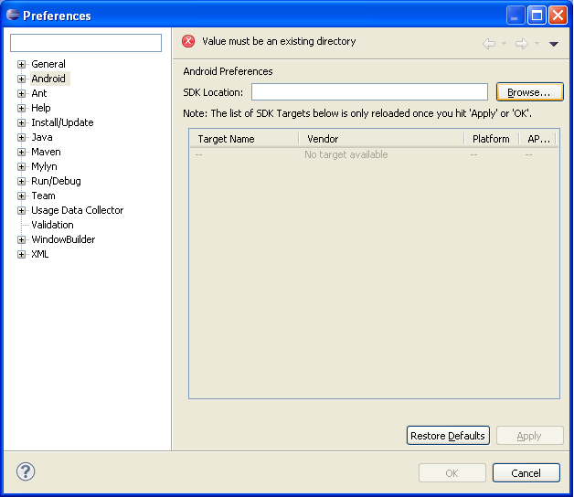
ADT Plugin (3)

Slide 10
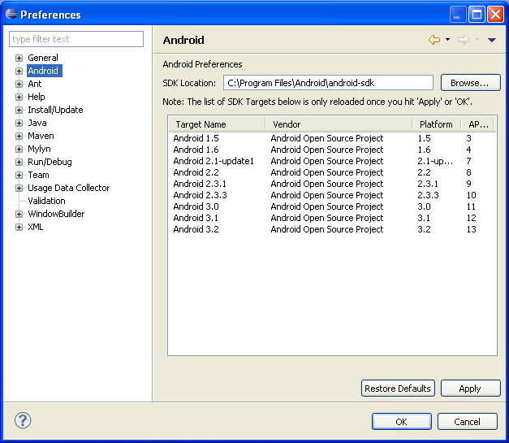
ADT Plugin (4)

Slide 11
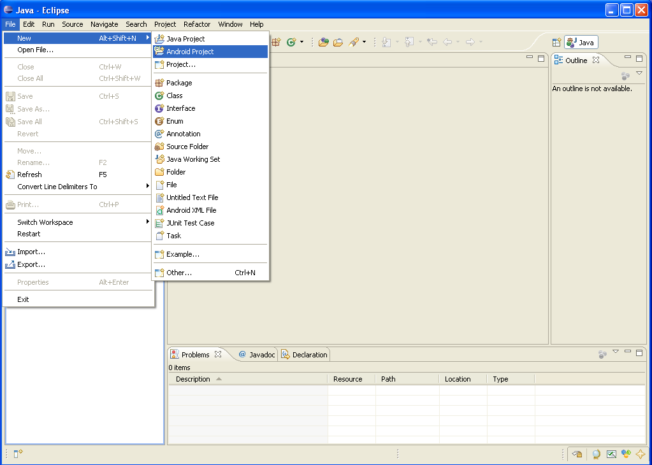
Creating a Project (1)

Slide 12
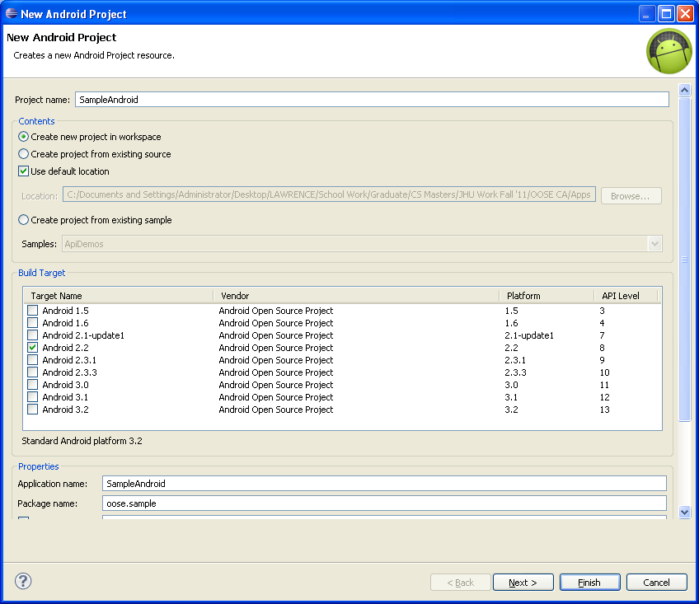
Creating a Project (2)
Need
the
items
circled
Then
click
Finish

Slide 13
Project Components
src – your source code
gen – auto-generated code (usually just R.java)
Included libraries
Resources
  Drawables (like .png images)
  Layouts
  Values (like strings)
Manifest file

Slide 14
XML
Used to define some of the resources
  Layouts (UI)
  Strings
Manifest file
Shouldn’t usually have to edit it directly, Eclipse can do that for you
Preferred way of creating UIs
  Separates the description of the layout from any actual code that controls it
  Can easily take a UI from one platform to another

Slide 15
R Class
Auto-generated: you shouldn’t edit it
Contains IDs of the project resources
Enforces good software engineering
Use findViewById and Resources object to get access to the resources
  Ex. Button b = (Button)findViewById(R.id.button1)
  Ex. getResources().getString(R.string.hello));

Slide 16
Layouts (1)
Eclipse has a great UI creator
  Generates the XML for you
Composed of View objects
Can be specified for portrait and landscape mode
  Use same file name, so can make completely different UIs for the orientations without modifying any code

Slide 17
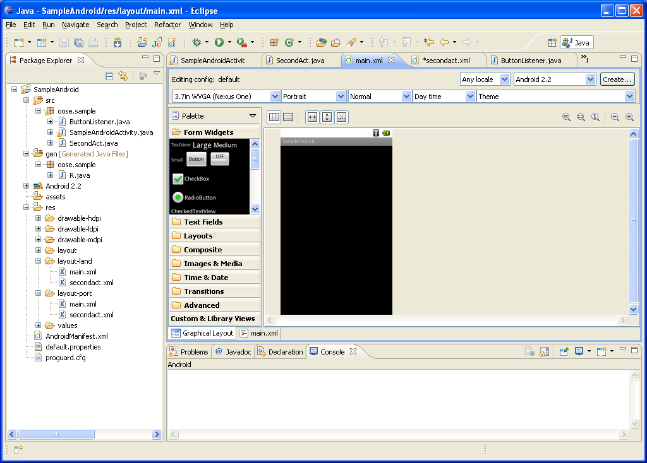
Layouts (2)

Slide 18
Layouts (3)
Click ‘Create’ to make layout modifications
When in portrait mode can select ‘Portrait’ to make a res sub folder for portrait layouts
  Likewise for Landscape layouts while in landscape mode
  Will create folders titled ‘layout-port’ and ‘layout-land’
Note: these ‘port’ and ‘land’ folders are examples of ‘alternate layouts’, see here for more info
  http://developer.android.com/guide/topics/resources/providing-resources.html
Avoid errors by making sure components have the same id in both orientations, and that you’ve tested each orientation thoroughly

Slide 19
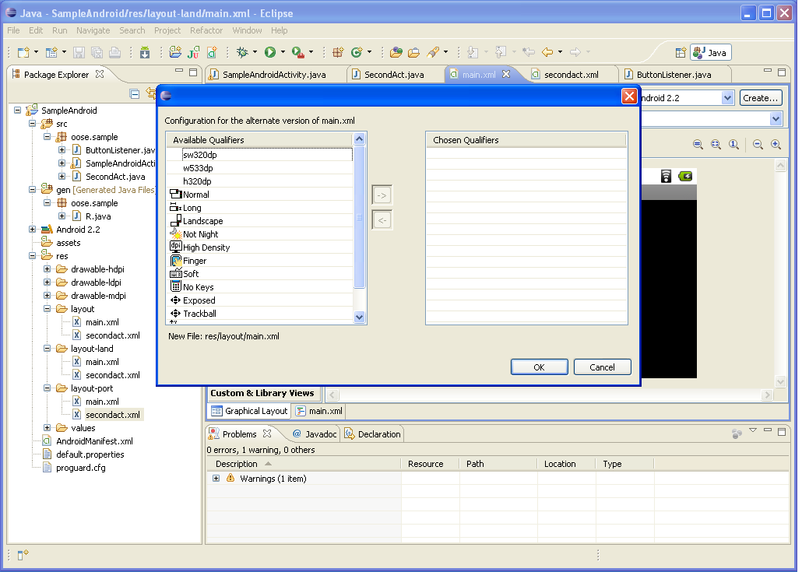
Layouts (4)

Slide 20
Strings
In res/values
  strings.xml
Application wide available strings
Promotes good software engineering
UI components made in the UI editor should have text defined in strings.xml
Strings are just one kind of ‘Value’ there are many others

Slide 21
Manifest File (1)
Contains characteristics about your application
When have more than one Activity in app, NEED to specify it in manifest file
  Go to graphical view of the manifest file
  Add an Activity in the bottom right
  Browse for the name of the activity
Need to specify Services and other components too
Also important to define permissions and external libraries, like Google Maps API

Slide 22
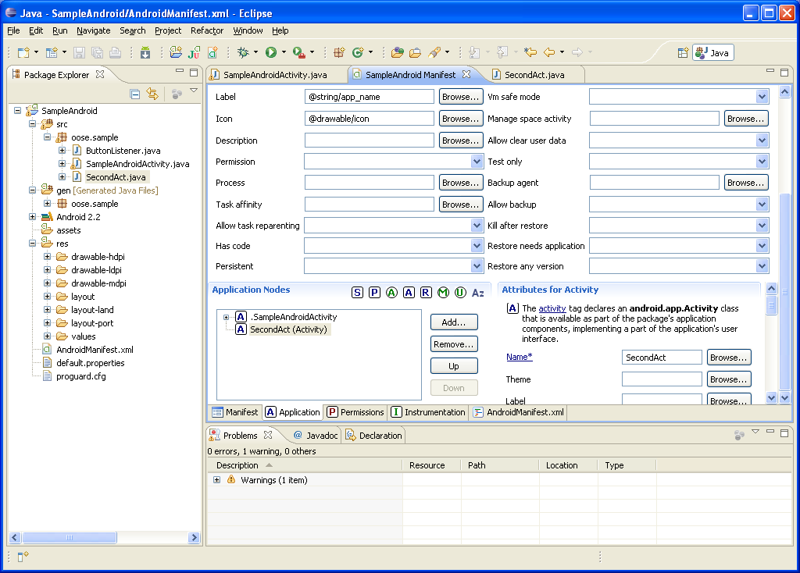
Manifest File (2) – Adding an Activity

Slide 23
Android Programming Components
Activity
  http://developer.android.com/guide/topics/fundamentals/activities.html
Service
  http://developer.android.com/guide/topics/fundamentals/services.html
Content Providers
Broadcast Receivers
Android in a nutshell:
  http://developer.android.com/guide/topics/fundamentals.html

Slide 24
Activities (1)
The basis of android applications
A single Activity defines a single viewable screen
  the actions, not the layout
Can have multiple per application
Each is a separate entity
They have a structured life cycle
  Different events in their life happen either via the user touching buttons or programmatically

Slide 25
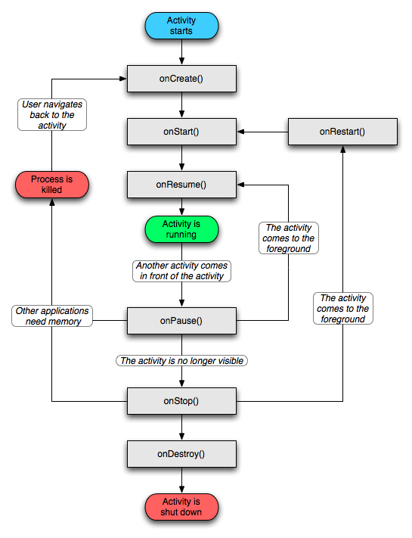
Activities (2)

Slide 26
Services (1)
Run in the background
  Can continue even if Activity that started it dies
  Should be used if something needs to be done while the user is not interacting with application
    Otherwise, a thread is probably more applicable
  Should create a new thread in the service to do work in, since the service runs in the main thread
Can be bound to an application
  In which case will terminate when all applications bound to it unbind
  Allows multiple applications to communicate with it via a common interface
Needs to be declared in manifest file
Like Activities, has a structured life cycle

Slide 27
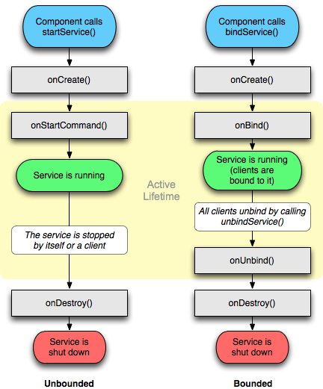
Services (2)

